Slide 1
Data collection Methods
Administering Questionnaires
Personally administered.
Sent through the mail.
Electronically administered.
Other techniques.
(see Figure 8.2)

Slide 2
Questionnaire Design
Definition
A questionnaire is a pre-formulated, written set of questions to which the respondent records his answers
Steps
Determine the content of the questionnaire
Determine the form of response
Determine the wording of the questions
Determine the question sequence
Write cover letter

Slide 3
Question Wording
Avoid double-barreled questions
Avoid ambiguous questions and words
Use of ordinary words
Avoid leading or biasing questions
Social desirability
Avoid recall depended questions

Slide 4
Question Wording
Use positive and negative statements
Dresdner delivers high quality banking service
Dresdner has poor customer operational support
Avoid double negatives
Limit the length of the questions
Rules of thumb:
< 20 words
< one full line in print

Slide 5
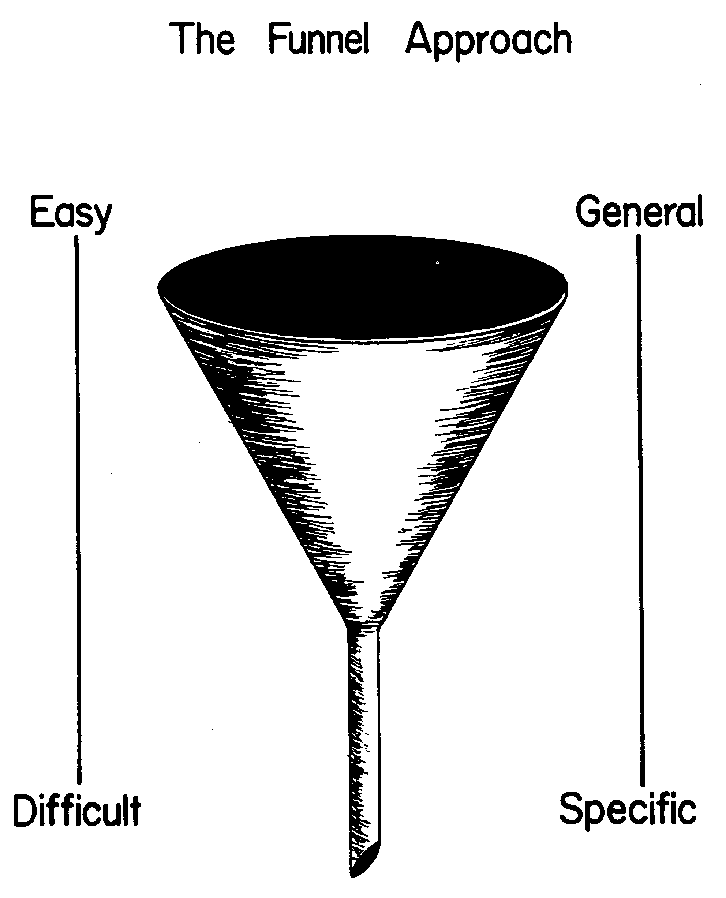
Question Sequence
Personal and sensitive data at the end
.

Slide 6
Guidelines for Questionnaire Design
Classification Data or Personal Information.
Personal information elicit such information as age, educational level, marital status, and income.
Unless absolutely necessary, it is best not to ask for the name of the respondent.
It is a matter of choice for the researcher to let the personal information appears in the beginning or at the end of the questionnaire.

Slide 7
Guidelines for Questionnaire Design
Classification Data or Personal Information.
It is a wise policy to ask for the personal information by providing a range of response options, rather than asking exact figures. For example, the variables can be tapped as shown below:

Slide 8
Guidelines for Questionnaire Design
Example 1
Age (years) Annual Income
Under 20 □ Less than $20,000
20 – 30 □ $20,000-30,000
31 – 40 □ $30,001-40,000
41 – 50 □ $40,001-50,000
51 – 60 □ $50,001-70,000
Over 60 □ $ Over 70,000

Slide 9
Principles of Measurement
There are some principles of measurement to be followed to ensure that the data collected are appropriate to test our hypotheses.
These refer to the scales and scaling techniques used in measuring concepts, as well as the assessment of reliability and validity or the measures used, which were all discussed before.

Slide 10
Principles of Measurement
Appropriate scales have to be used depending on the type of data that need to be obtained.
Wherever possible, the interval and ratio scales should be used in preference to nominal or ordinal scales.
Once data are obtained, the “goodness of data” is assessed through tests of validity and reliability. Validity establishes how well a technique, instrument, or process measures a particular concept, and reliability indicates how stably and consistently the instrument taps the variable.

Slide 11
General Appearance of the Questionnaire
It is necessary to pay attention to how the questionnaire looks. An attractive and neat questionnaire have the following elements:
A good introduction
Organizing questions
Giving instructions and guidance
Good alignment
These elements are briefly discussed with examples.

Slide 12
Cover Letter
The cover letter is the introductory page of the questionnaire
It includes:
Identification of the researcher
Motivation for respondents to fill it in
Confidentiality
Thanking of the respondent
.

Slide 13
General Appearance of the Questionnaire
Example 2
A production manager wants to assess the reactions of the blue-collar workers in his department to the introduction of computer-integrated manufacturing (CIM) systems. He is particularly interested to know how they would perceive the effects of CIM on:
a. their future jobs
b. additional training that they will have to receive
c. future job advancement.
Design a questionnaire for the production manager.

Slide 14
General Appearance of the Questionnaire
Questionnaire
Jordan Software Enterprises
P.O.Box 2231
Amman-Jordan
Date-----
Dear Employee,
As we had discussed in our meetings, Computer Integrated Manufacturing (CIM) will form a part of our operations in the future. We would like to know how you visualize certain aspects of the future environment as we introduce the changes.
Please take a few minutes to complete this short questionnaire and return it to the locked box in the headquarter office.
Thank you for responding within the next five days.
Ahmad Rasheed
Production Manager

Slide 15
General Appearance of the Questionnaire
1. Personal information ( place a mark on the appropriate place)
Job Status Number of years
Worked in the Department
--Machinist -- Less than 1
--Inspector -- 1-2--
--Forman -- 3-5
--Surveyor -- 5-10
-- Other -- Over 10 years

Slide 16
General Appearance of the Questionnaire
2. Your Opinion regarding the following.
Please circle the appropriate number for each of the following items using the scale below.
Strongly Neither Agree Strongly
Agree Agree Nor Disagree Disagree Disagree
1 2 3 4 5
1. I will need additional training 1 2 3 4 5
to work in the changed
environment.
2. The new system will offer me 1 2 3 4 5
better opportunities for
advancement.
3. The opportunities for training 1 2 3 4 5
will have to be enhanced with
CIM.

Slide 17
General Appearance of the Questionnaire
4. I am not sure if CIM will need 1 2 3 4 5
all the people we now have in
this department.
5. I feel that most of us may not 1 2 3 4 5
have better opportunities for future
promotions in the new manufacturing
environment.
6. Most of us will need special 1 2 3 4 5
training to work with CIM.
7. I am sure the future looks bright 1 2 3 4 5
for most of us here.

Slide 18
General Appearance of the Questionnaire
Items 4 and 7 measure opinion about their future jobs.
1, 3, and 6 measure perceived training needs.
2, and 5 measure job advancement.

Slide 19
General Appearance of the Questionnaire
Example 3
The president of Mideast Co. suspects that most of the 500 male and female employees of the organization are somewhat alienated from work.
He is also of the view that those who are more involved (less alienated) are also the ones who experience greater satisfaction with their work lives.
Design a questionnaire the president could use to test his hypothesis.

Slide 20
General Appearance of the Questionnaire: Example 3
Before we can design a questionnaire, we need to list the variables to be tapped and operationally define the more abstract concepts. The following variables are mentioned in the study:
1. Involvement (or the other end, alienation).
2. Satisfaction with work life.

Slide 21
General Appearance of the Questionnaire: Example 3
The following demographic variables might be of interest to the study:
3. Gender
4. Tenure (number of years in the organization)
5. Job level
6. Age
7. Education
These demographic variables help to describe the sample, also, they might have an influence on the involvement (or alienation) of the employees, their level of satisfaction, and the relationship between the two.

Slide 22
General Appearance of the Questionnaire: Example 3
Operational Definition of Involvement would include the dimensions of the job being of central interest to individuals, and the major happiness being derived from the job. Low involvement can be considered as alienation.
Items that measure involvement are:
1. The major happiness of my life is derived from my job.
2. Time at work flies by quickly.
3. Working here is boring.
4. Nothing in life is as important as work.
5. I live, eat, and breathe my job.
6. My work helps me establish who I am.

Slide 23
General Appearance of the Questionnaire: Example 3
Operational Definition of Satisfaction would include dimensions of satisfactions with various aspects of the work environment such as with pay, supervision, promotion, and the like.
Questions that describe satisfaction at work place are:
To what extent would you agree with the following statements?
My work is fascinating.
My work gives me a sense of accomplishment.
My supervisor praises good work.

Slide 24
General Appearance of the Questionnaire: Example 3
My pay is barely adequate to take care of my expenses.
My co-workers are very stimulating.
The opportunities for advancement are very good here.
I get a lot of cooperation at the workplace.
People can live comfortably with their pay in this organization.
My supervisor is not very capable.
The promotion policies here are very unfair.

Slide 25
Questionnaire Mideast Company, Inc. P.O.Box 2345 Amman-Jordan
December 4, 2020
Dear Employee,
As the president of your company, I am interested in conducting a mini survey on your reactions to working in this organization. Your responses would give me an indication of any changes that may be necessary for offering you a better quality of work life. Your honest and straightforward answers will aid me to help you. I do not need your names- only truthful answers. Suggestions from you will be implemented by a Committee if considered suitable.
Thank you for responding within a week’s time.
My best wishes
Mohammad Al-Farouki, President

Slide 26
General Appearance of the Questionnaire: Example 3
Please check the blanks most appropriate for the items below.
1. Personal Data
Department in which you are working:-------------
i. Age (years) ii. Education iii. Sex
- under 25 - high school - F
- 25-35 - college - M
- 36-45 - bachelor’s degree
- 46-55 - master’s degree
- over 55 - doctoral degree
- other

Slide 27
General Appearance of the Questionnaire: Example 3
iv. Job Level v. Number of years in this
organization
- manager - less than 1
- supervisor - 1-3
- clerk - 4-8
- secretary - 9-15
- technician - over 15 years
- other (specify)

Slide 28
General Appearance of the Questionnaire: Example 3
2. Here are some questions that ask you to tell us how experience your work life in general. Please circle the appropriate number of the scales below.
On a scale of 1 to 5, (1) denoting very low agreement and (5) denoting very high agreement, to what extent would you agree with the following statements?

Slide 29
General Appearance of the Questionnaire: Example 3
Very Very
Low High
1. The major happiness
Of my life is derived
From my job. 1 2 3 4 5
2. Time at work flies by
Quickly. 1 2 3 4 5
3. Working here is boring 1 2 3 4 5
4. Nothing in life is more
important than work. 1 2 3 4 5
5. I live, eat , and breathe
my job. 1 2 3 4 5

Slide 30
General Appearance of the Questionnaire: Example 3
6. My work helps me
establish who I am. 1 2 3 4 5
7. My work is fascinating. 1 2 3 4 5
8. My work gives me a
sense of accomplishment 1 2 3 4 5
9. My supervisor praises
good work. 1 2 3 4 5
10.My pay is not adequate 1 2 3 4 5
to take care of my
expenses.
11.My co-workers are
very stimulating. 1 2 3 4 5

Slide 31
General Appearance of the Questionnaire: Example 3
12.The opportunity for
advancement is very
good here. 1 2 3 4 5
13.I get a lot of co-
operation at the
workplace. 1 2 3 4 5
14.People can live comfortably
with their pay in this
organization. 1 2 3 4 5

